Slide 1
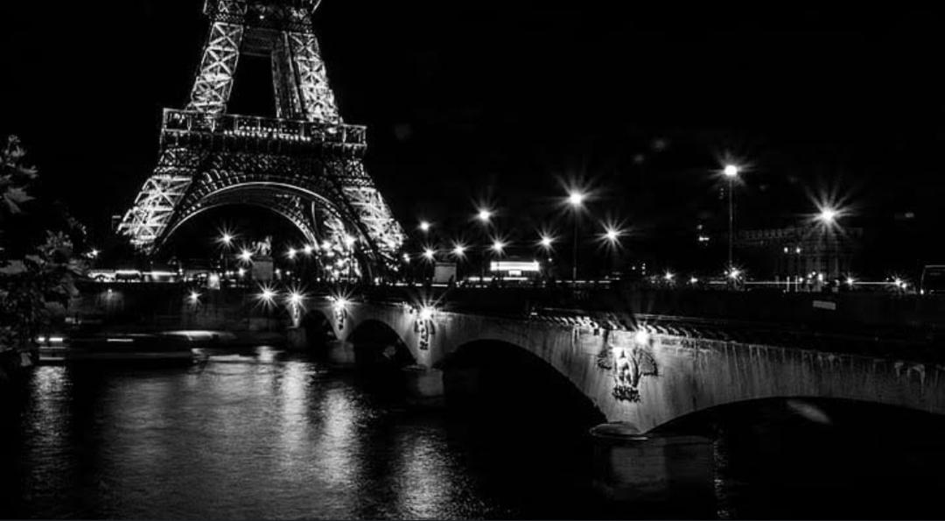
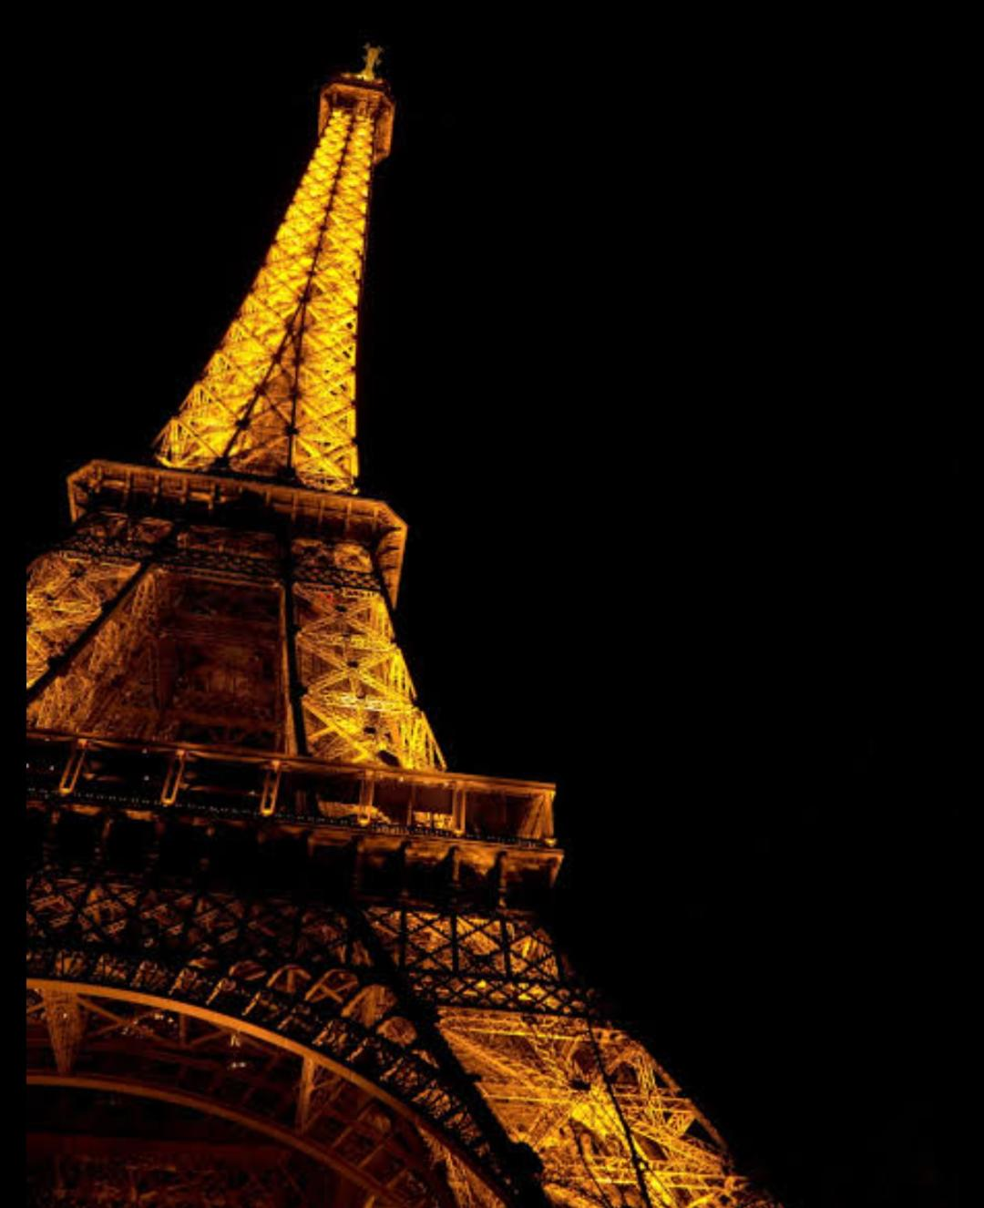
France
France

Slide 2
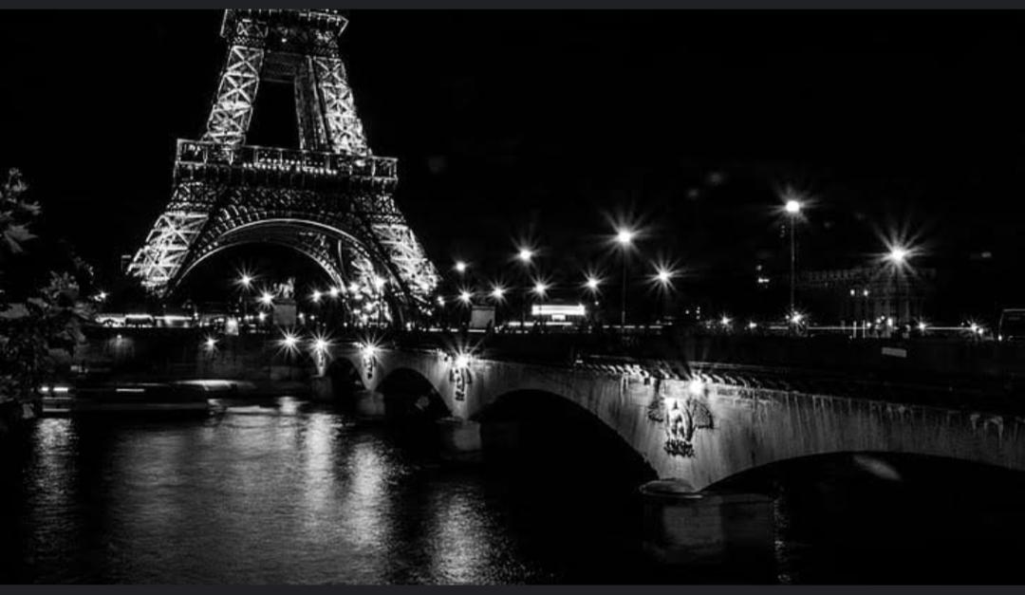
The capital city
France is a semi- presidential Republic with its capital in paris,
the nation’s largest City and the main cultural and commercial center.

Slide 3
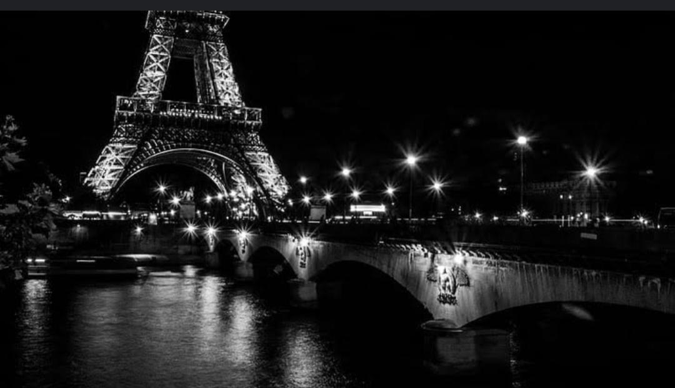
The area
By area, France is the 42nd largest country in Western Europe and the European Union (EU), and the third-largest in Europe as a whole, and it has 551,500 square kilometres.

Slide 4
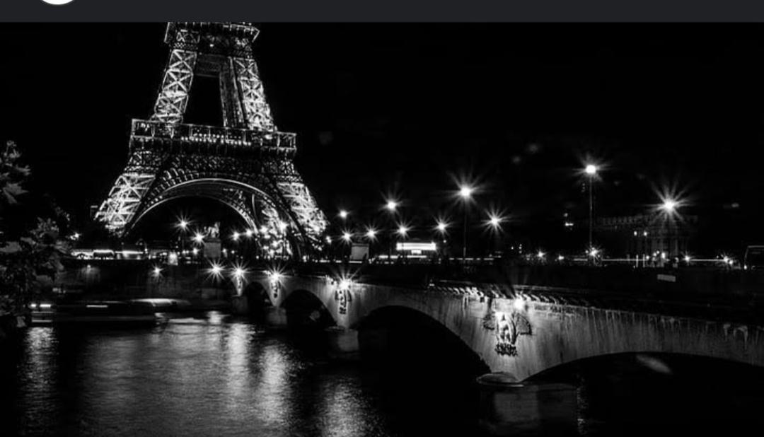
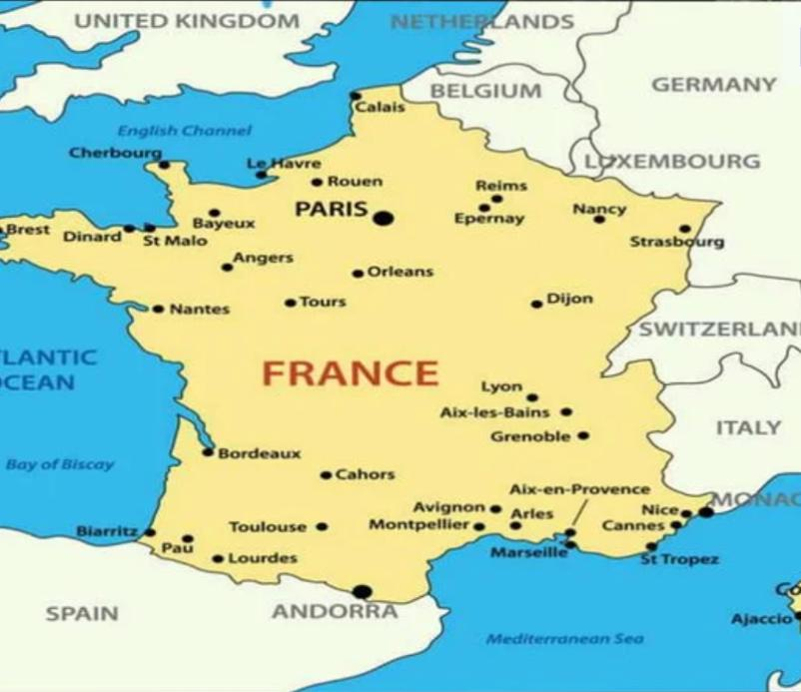

Slide 5
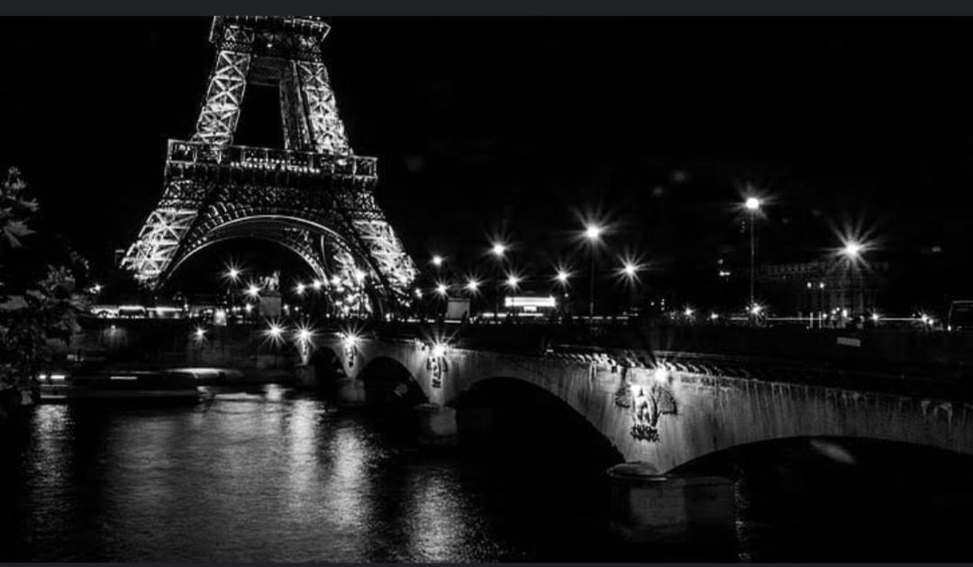
Whether and Climate
* South along the Mediterranean: Mostly sunny days throughout the year.
* Southwest: Fairly sunny, wet spring, and summers can get very hot and humid.
* Northeast: Cold and m piostly rainy falls and winters.
* Northwest: Mild summers and rainy winters.

Slide 6
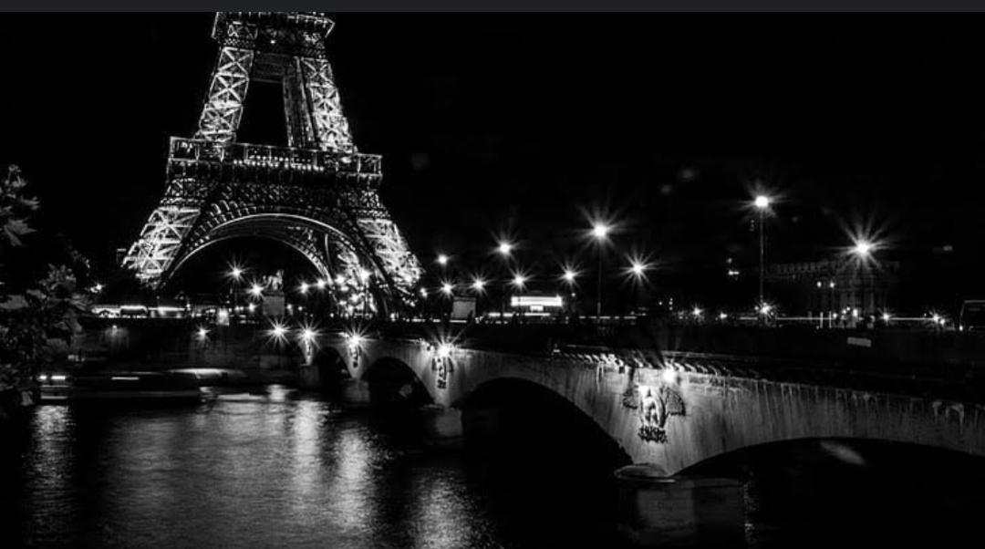
Population
With a population approaching 67 million, it is the 20th most populated country and the second- most populated country in the EU

Slide 7

Government
* Centralised government * President is elected for a five-year term * Semi- presidential system * Based on the French Constitution of the fifth Republic * Declares itself as “an indivisible, secular, democratic and social Republic” * The National Assembly is the lower house of the Parliament.

Slide 8
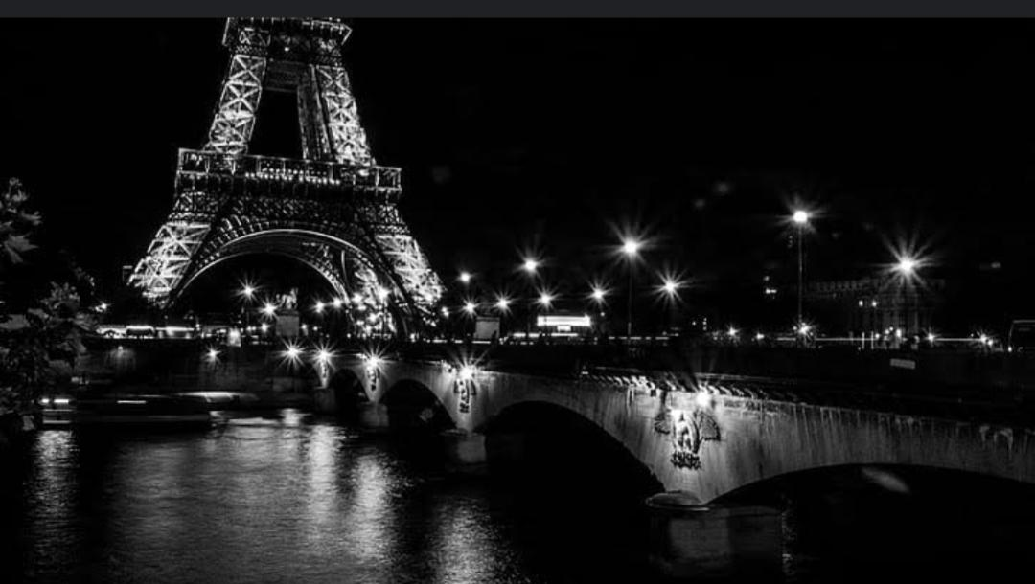


• The national flag
• The National logo

Slide 9
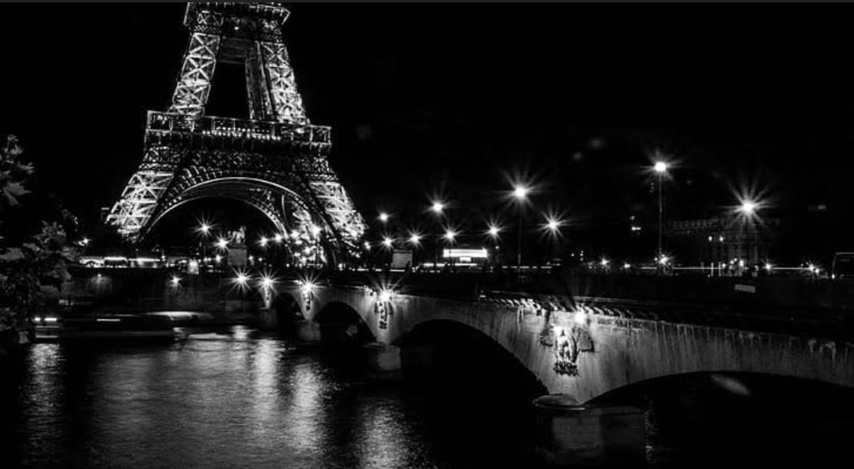
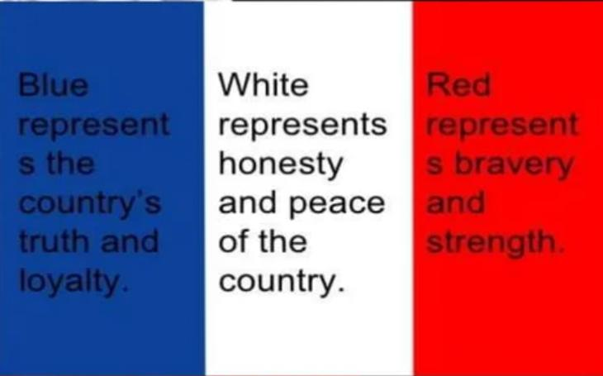
The meaning of the colour of the flag

Slide 10
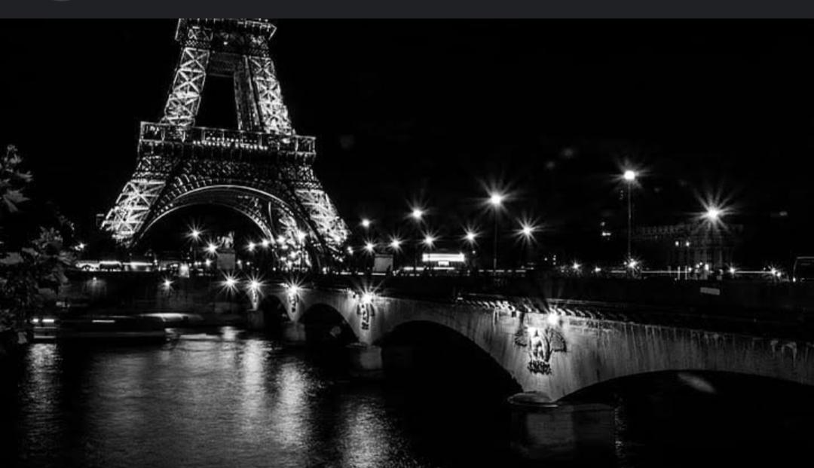
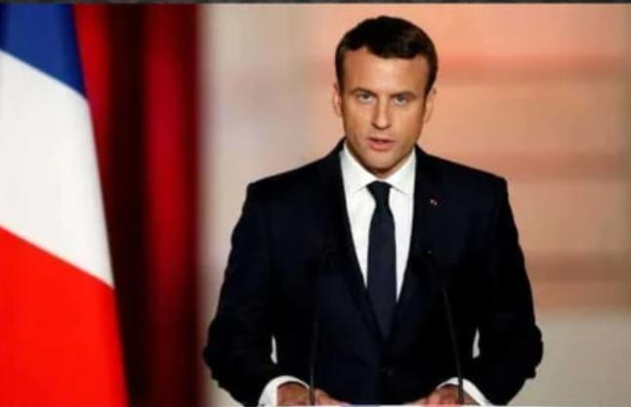
President of Franch republic
-Emmanuel Macron-

Slide 11
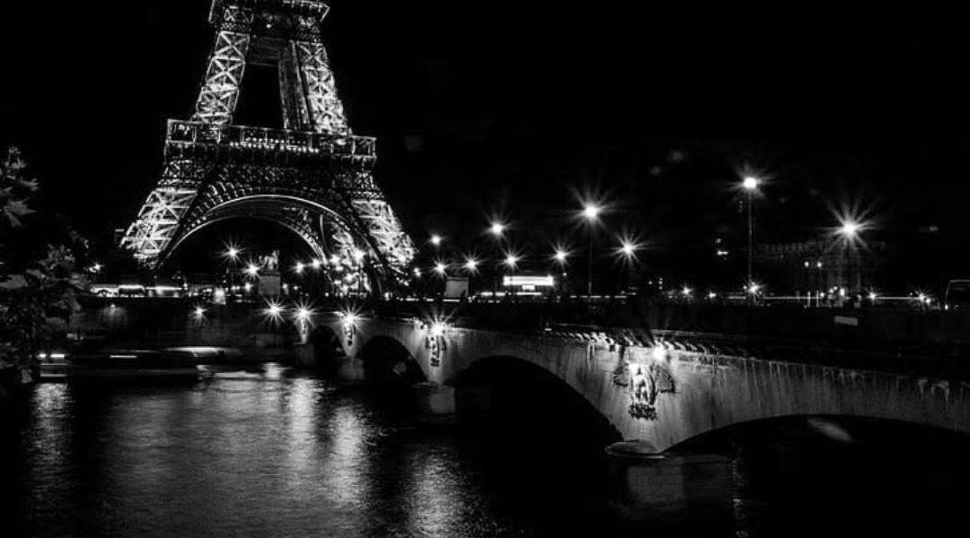
Transportation
•Air : ~Approximately 478 airports ~All major cities in France have airports. •Car : ~Approximately 500,000 miles of serviceable roadway.

Slide 12

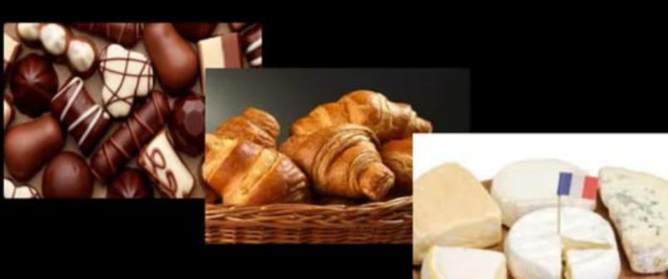
French food
The French are also famous for their cuisine. French food known in the world are chocolates, cheese and breakfast like croissants.

Slide 13

Sports
* The French “national” sport is football * The most-watched sports in France are football, rugby, basketball, cycling, sailing and tennis. * Sport is encouraged in school, and local sports clubs receive financial support from the local governments.

Slide 14

Language
•Official language of France is french •88% of the population speaks French •75 different languages in France. •24 of these languages are European rest of the languages include languages from the South American,South Asian and Caribbean regions

Slide 15

French music
* Indigenous Folk Music and features styles from Africa, Latin America, and Asia. * Most well known for its classical music * Modern times is known for the development of hip hop, techno, funk, and pop.

Slide 16

Holidays & Festival
* Bastille Day (July 14th) was incorporated in 1789. * Armistice Day (November 11) was incorporated in 1918. * Labour Day (May 1) was incorporated in 1935. * Holiday’s nearly every week in the month of May. * Many regional festivals throughout France. * Every French citizen is entitled to 5 weeks of vacation.

Slide 17
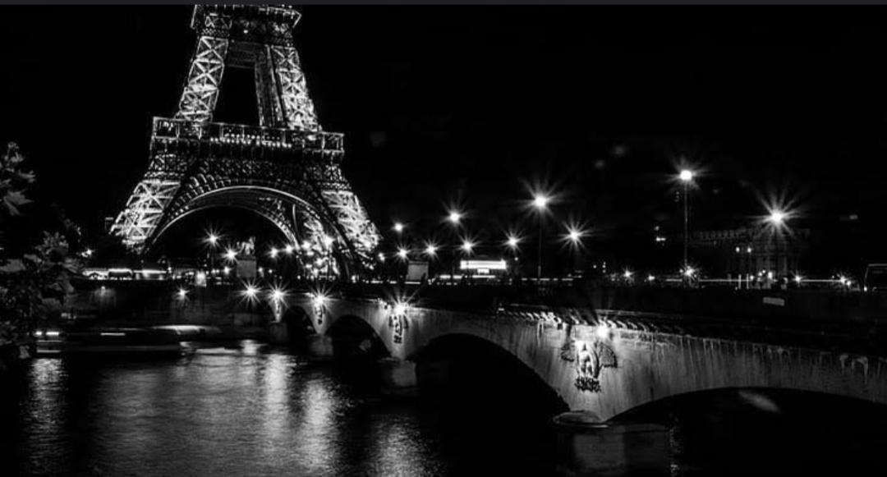
Conclusion
The French Revolution stands as a transformative event in world history, catalyzing profound social, political, and cultural changes that continue to resonate in the modern era.

Slide 18

By...
B. Preethi
R. Preethi
I. Hasmathul haseena
V. Narmadha
E. P Deepika
Thank you..

